Slide 1

Customer Segmentation
Name: XYZ Bank
Location: Zimbabwe
Team: DGI
Date: 15-05-2021

Slide 2

Agenda
Meet the Team
Problem Description
Business Understanding
Github link and Data Overview
EDA Summary
Proposed Model Technique

Slide 3
Meet the Team
Github Link: https://github.com/shelovescode000/CustomerSegmentationProject

Slide 4
Problem Description
The Bank XYZ wants to roll out personalized Christmas offers for certain customers instead of rolling out the same offers for all customers. As an alternative of trying to manually decide which customer is which category. The bank seeks an efficient approach that enables them to uncover hidden patterns in their customer data and categorize customers into a 5 unique groups.

Slide 5
Data Overview
1 data set (cust_seg.csv)
The full data set consists of 48 variables and 1,000,000 observations.
Assumptions:
The data was skewed so we dropped the outliers.
Some variables were dropped because they were considered useless i.e. some customers didn’t have a province code.
Variables are arranged in order of importance.
Manipulations:
The fecha_alta variable which is the date which the customer became the first holder of a contact at the bank was changed by subtracting the customer’s date with the max date 2015-01-28 to get the number of years since first contract. This created a new column called fecha_alta_year.
The 24 variables that start with the letters ind_ and end with the letter _ult1 which describe the different accounts or products the customers use was summed up to one variable which counts the number of products each customer makes use of in the bank. This created a new variable named number_of_accounts.

Slide 6
Exploratory Data Analysis
Duplicate values: approximately 37.3% of the data was duplicates
Approximately 40% of the data was discarded for the analysis after data cleaning and transformation

Slide 7
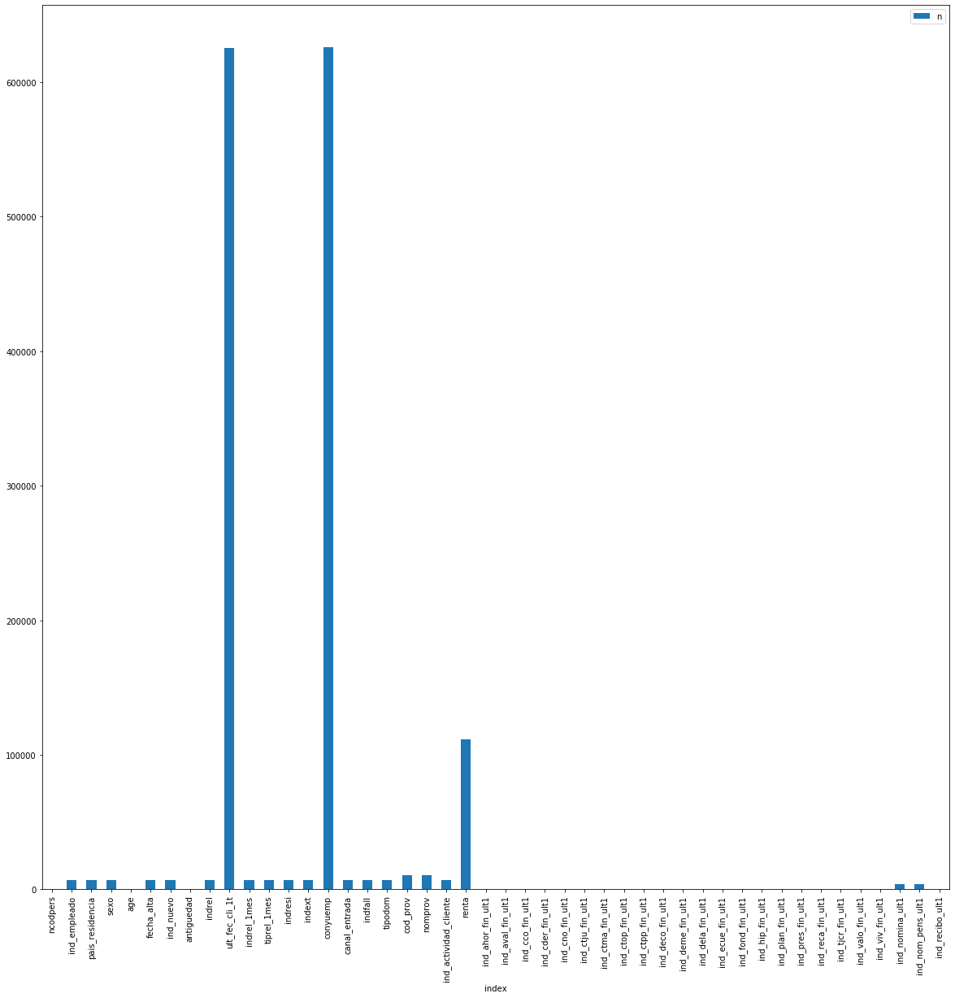
EDA: Missing Values
Variables with more than 80% missing values were removed.
The other missing values were replace using different machine learning methods.

Slide 8
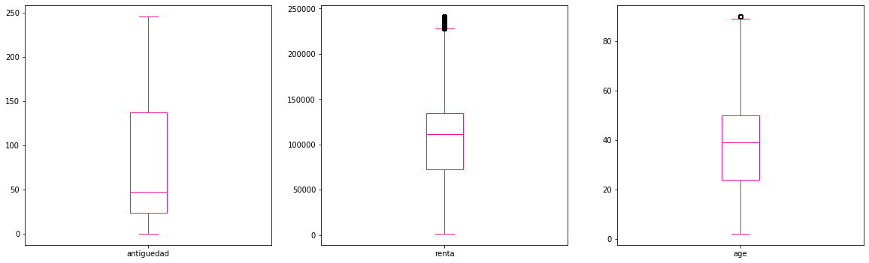
EDA: Outliers
The renta variable and age variable contained some outliers. Thus, the outliers were removed from this analysis to obtained accurate results.

Slide 9
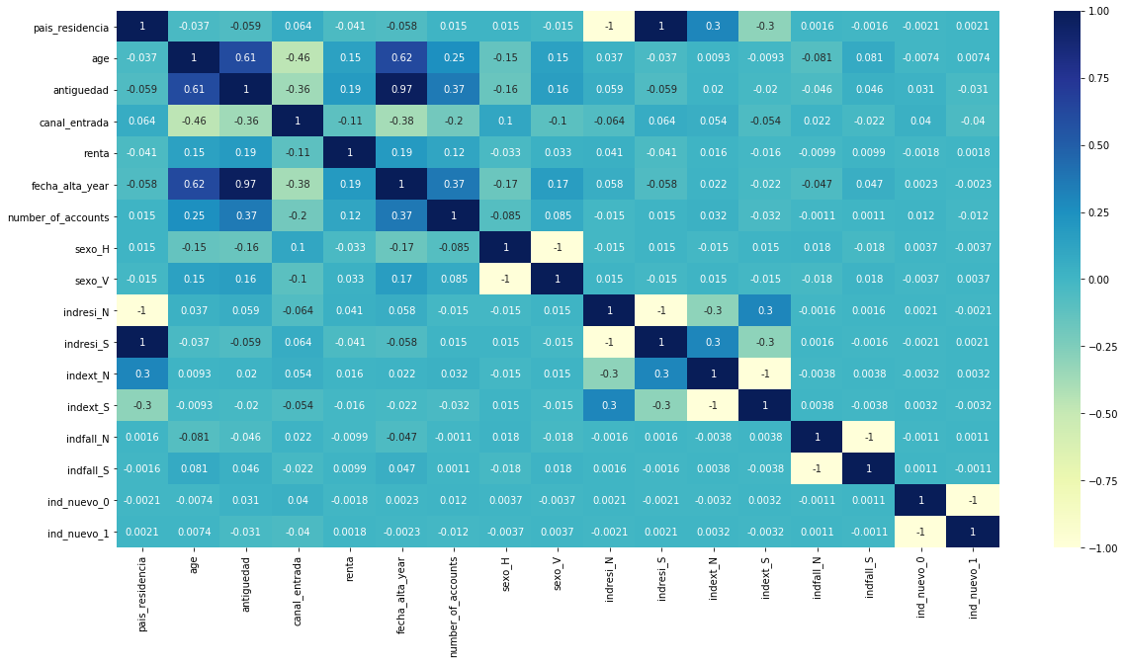
EDA: Correlation
Most variables in the data set were correlated. For example, pais_residencia and residence index (indresi), indresi depends on pais_residencia.
Correlated meaning that the variables provided the same information, thus, there is no use keeping both variables.

Slide 10
Recommendations
From the Exploratory data analysis, it was observed most of the missing data was from foreign customers.
The most active customers are local customers.

Slide 11
Proposed Model Technique
Modelling and Model Selection:
For the task we were given features only and no target variables. The aim of the task is to cluster the customers into 5 groups. Thus, clustering algorithms such as K Means clustering and Hierarchical clustering were considered for this task.
Recommended Models:
K Means
Hierarchical Clustering
Model Selection
The K Means was selected as the best model because it was able to handle a large data set while the hierarchical clustering threw a memory error.
KMeans
KMeans is a partitioning method non-hierarchical clustering algorithm , it is less complex and easy to implement when compared to others clustering algorithm.
It is an iterative process where you are trying to minimize the distance of the data point to the average data point in the cluster.
One of the major application of KMeans clustering is segmentation of customers to get a better understanding of them which in turn could be used to roll out the personalized offers from the bank.
This method works best for huge datasets.

Slide 12
Thank You

